Slide 1
SpringerProtocols
The world’s most comprehensive collection of high quality peer-reviewed life sciences protocols
William Chiuman
eProduct Manager, Expert Databases

Slide 2

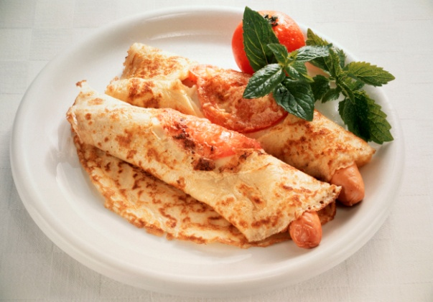

What is a protocol?

Slide 3
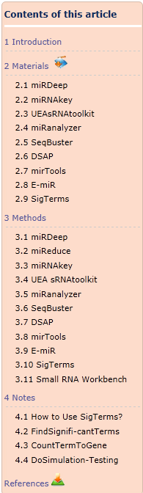
What is a protocol?
  Used primarily in life sciences
  Step-by-step instructions that help researchers conduct experiments
  Verified written procedures in the design and implementation of experiments including:
    Background information
    Materials
    Equipments
    Methods
    Sample results
    Tips/Troubleshooting
    Safety
    References

Slide 4
Why a protocol is so important?
Scenario
Impact
Using laboratory methods published in literature
Essential details are excluded
Using methods from previous experiments
Possibility of comprising reliability of results and valuable time spent
Using protocols from free source
Details are missing; results are not reliable
Using a resource lacking a critical mass of protocols
Valuable research time is spent to locate methods or start from scratch
Notes:
难点，细节，缺乏trouble shooting
法帖子

Slide 5
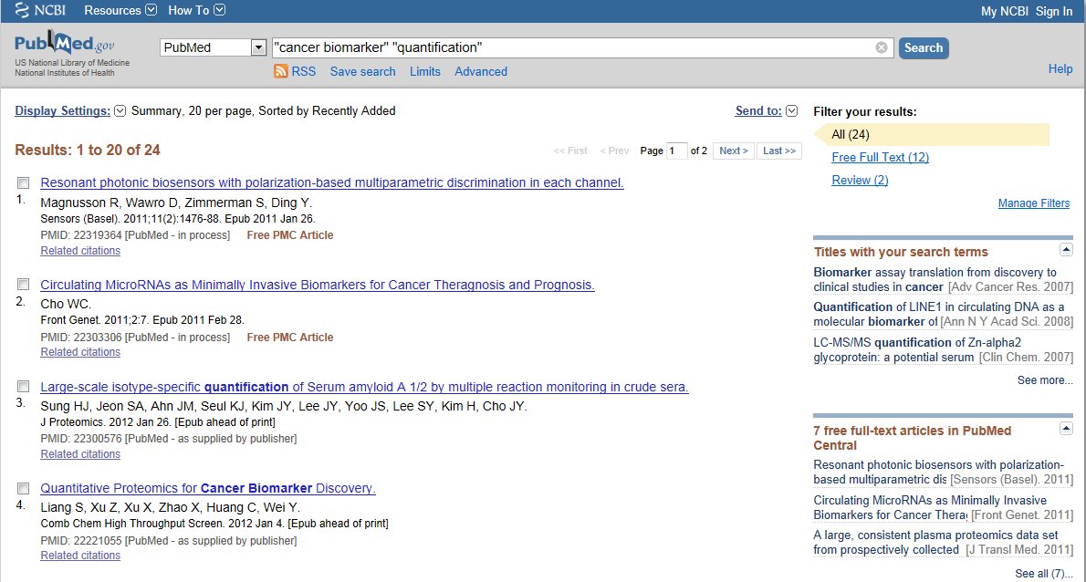
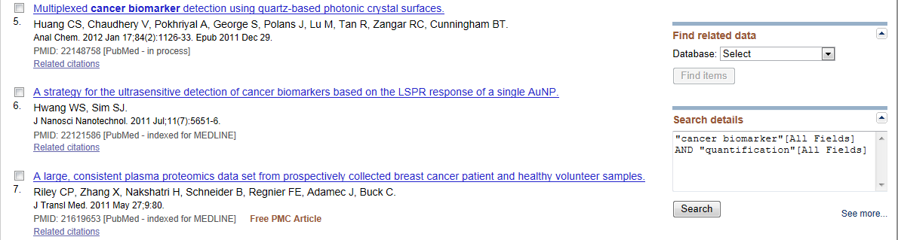
Where can I find a protocol?
?
?
?
?
?
?

Slide 6
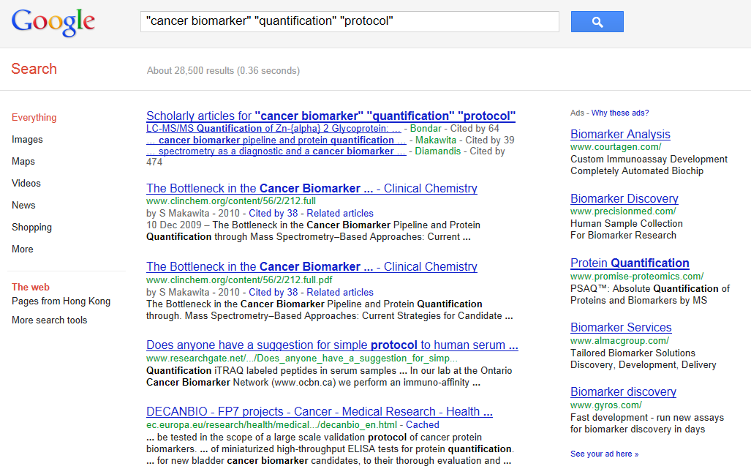
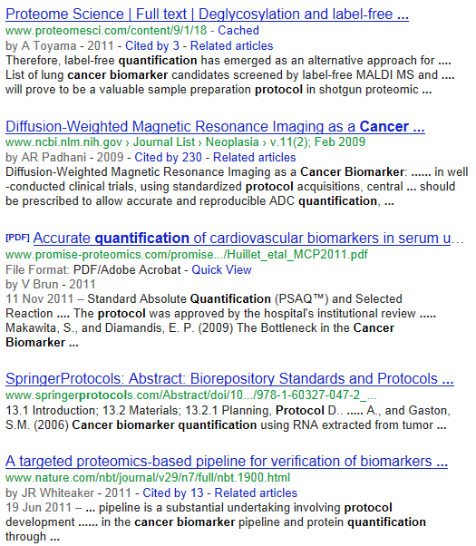
Where can I find a protocol?
?
?
?
?
?
Notes:
搜索结果很多，在里面很难找到完整可靠地protocol

Slide 7
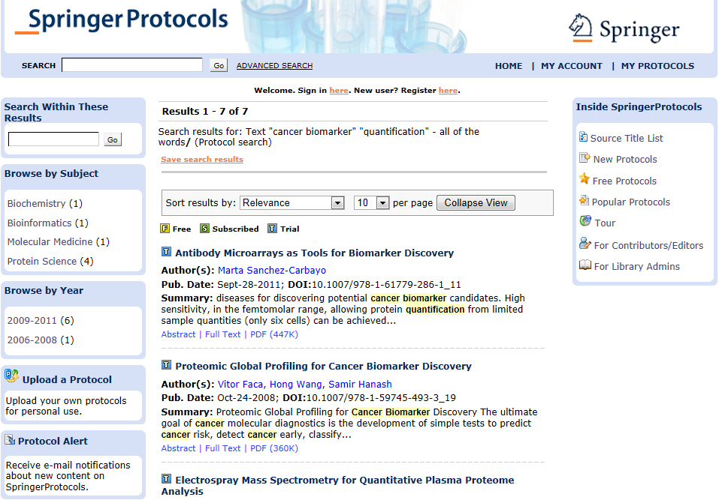
Where can I find a protocol?

Slide 8




Where can I find a protocol?
As of 24 Feb 2012:
Publisher | Product | Protocols | Annual Content Increase | Update Frequency | First Year
Wiley | Current Protocols | 13,674 | 500-700 | Quarterly | 1987
Nature | Nature Protocols | 1,488 | 360 | Monthly | 2006
Cold Spring Harbor | CSH Protocols | 2,278 | N/A | Monthly | 2006
Springer |  | 26,334 | 2,000 | Continuously | 1984
Notes:
查新

Slide 9
SpringerProtocols
DEMO

Slide 10




SpringerProtocols - Content
Book Series (1106)
  Methods in Molecular Biology
  Methods in Molecular Medicine
  Neuromethods
  Methods in Biotechnology
  Methods in Pharmacology and
  Toxicology
Stand alone books (25)
Journals
  Molecular Biotechnology
  Biological Procedures Online
Alternative protocols are available!
Notes:
对于不同的实验室环境呢，我们还有几种备选的protocol来配合不同的实验条件和设备

Slide 11
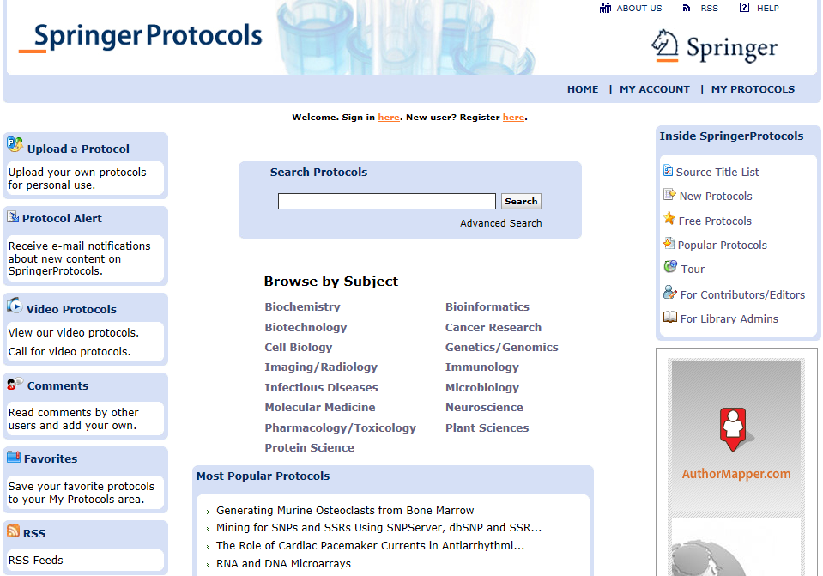
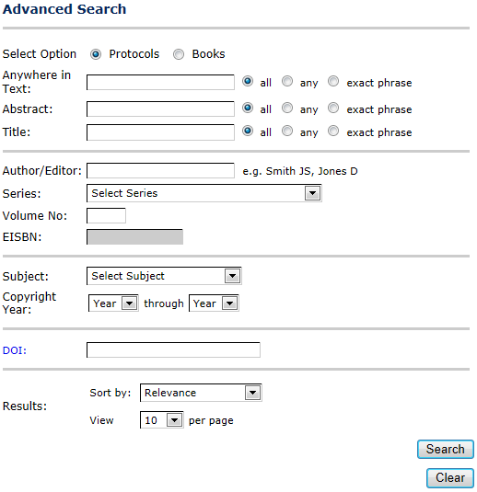
SpringerProtocols - Platform
Notes:
主页
快速搜索
高级搜索
主题
常规
浏览
个性化设置

Slide 12
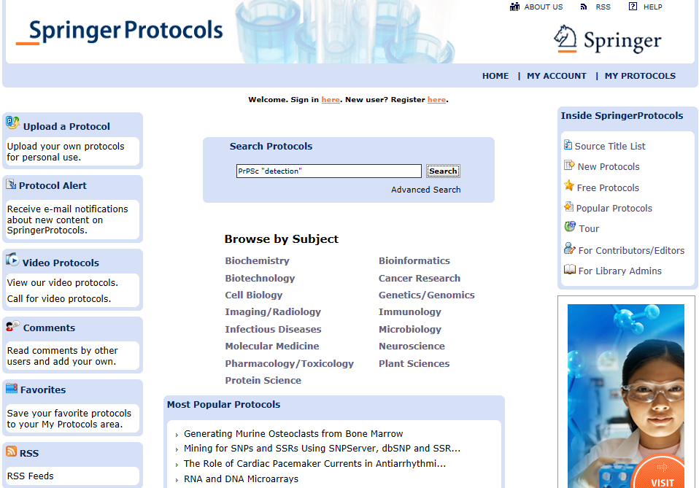
SpringerProtocols - Search

Slide 13
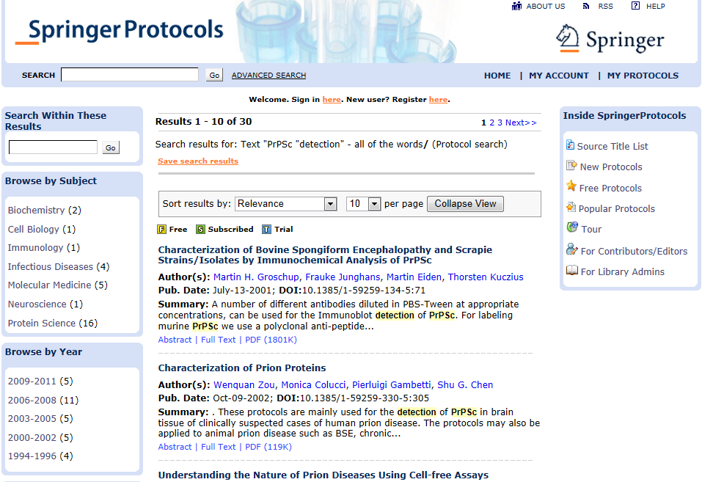
SpringerProtocols - Search

Slide 14
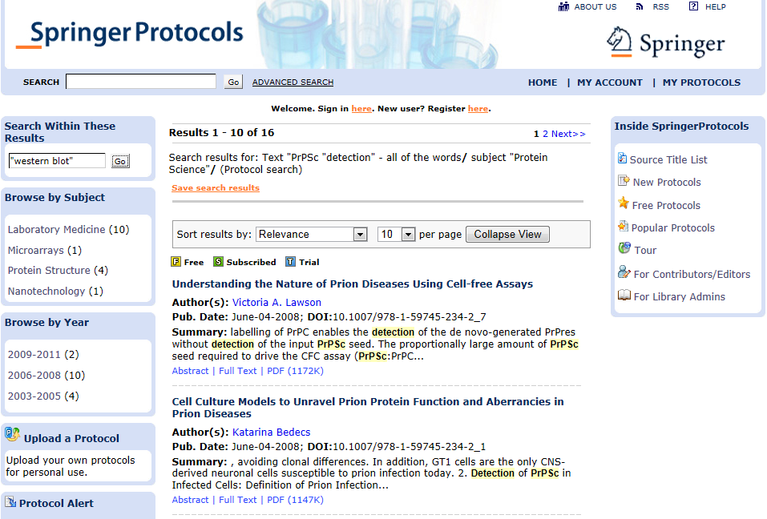
SpringerProtocols - Search

Slide 15
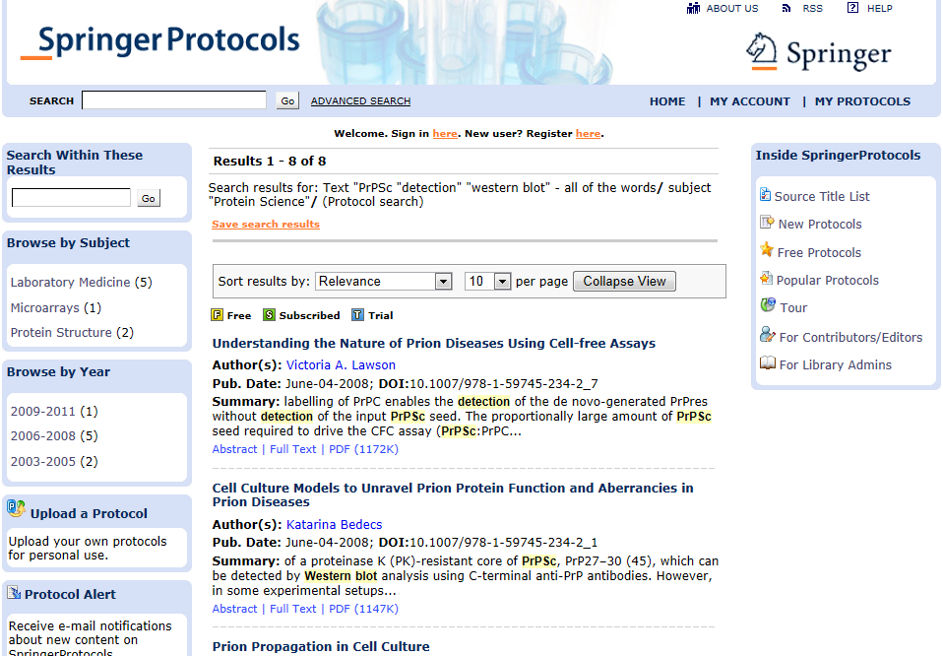
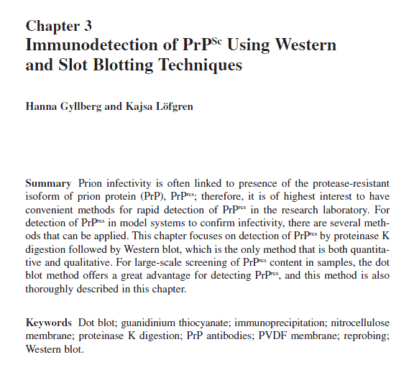
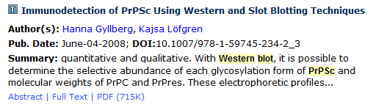
SpringerProtocols - Search

Slide 16
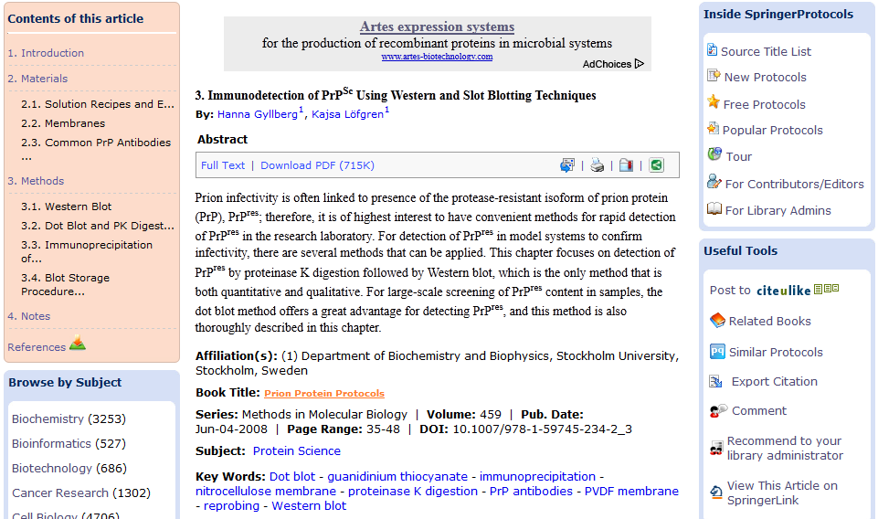
SpringerProtocols - Search
Print
Save
E-mail
Bookmark
Notes:
网页版

Slide 17
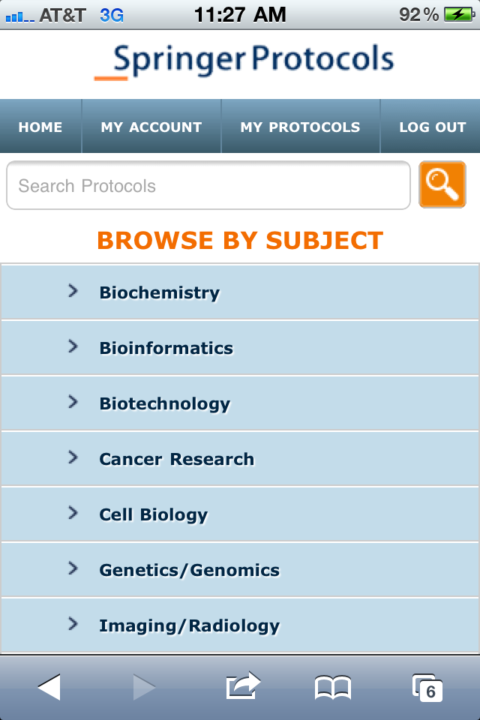
SpringerProtocols – Go Mobile
Web-based application which runs on
Apple, Android and BlackBerry operating
systems.
Simply navigate to springerprotocols.com
on your mobile device!
Notes:
支持现在所有主流的系统
安卓，苹果和黑莓

Slide 18
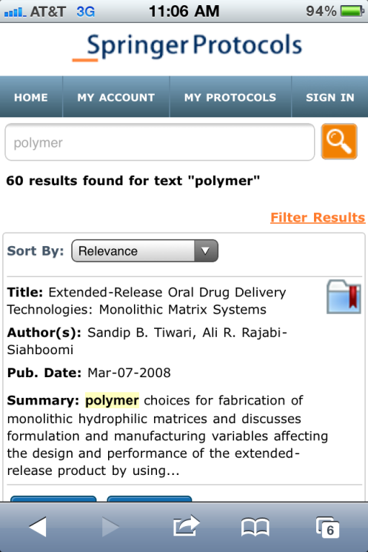
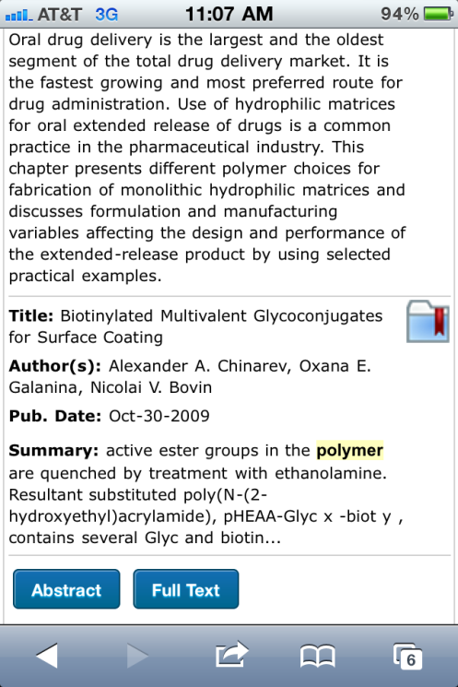
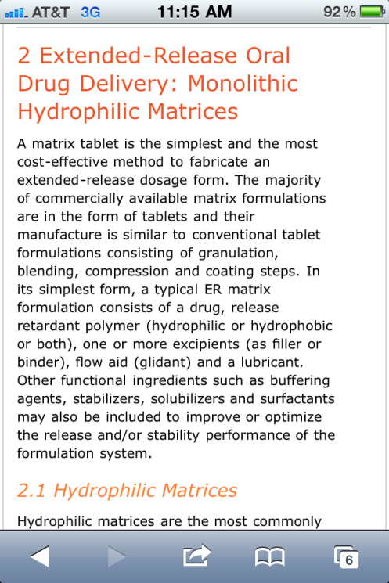
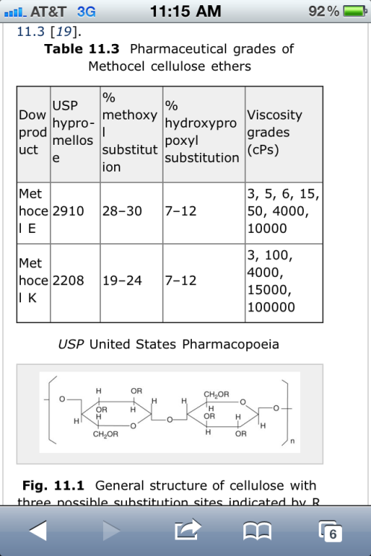
SpringerProtocols – Go Mobile
Search and drill down through protocols of interest whenever and wherever you wish!

Slide 19
SpringerProtocols
LIVE DEMO

Slide 20
SpringerProtocols
If you have any question, please contact me at william.chiuman@springer.com.

Slide 21
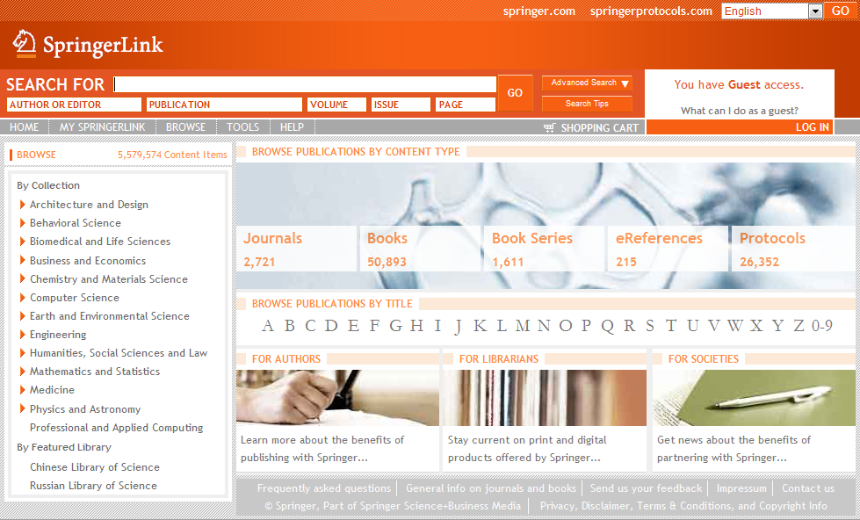
Protocols in SpringerLink

Slide 22
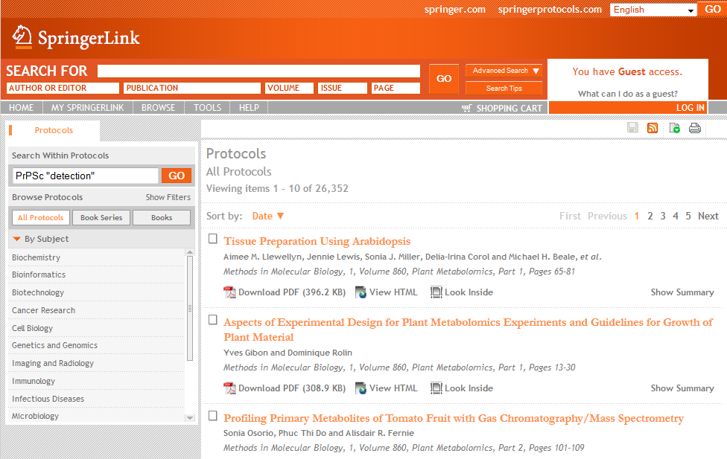
Protocols in SpringerLink

Slide 23
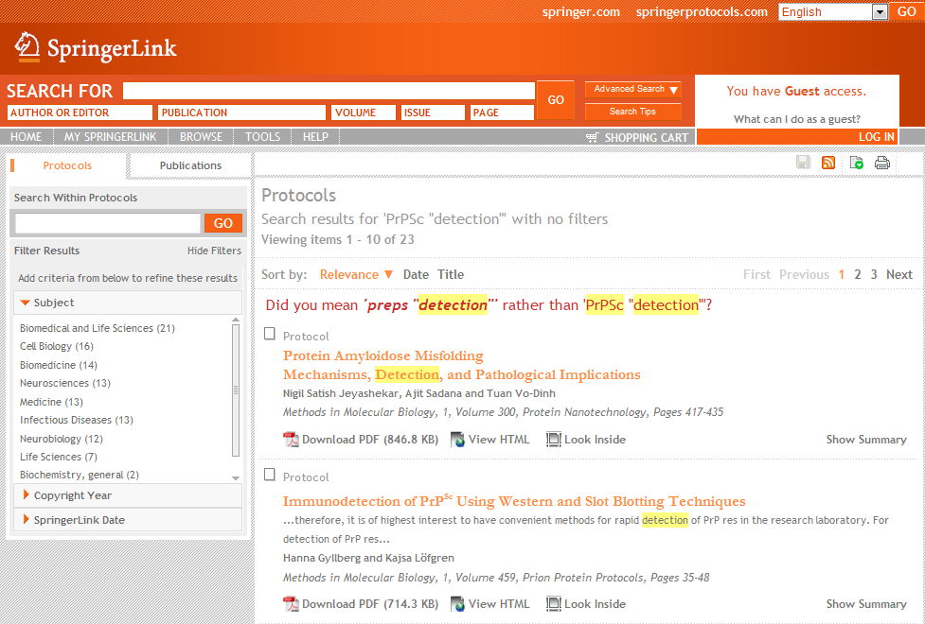
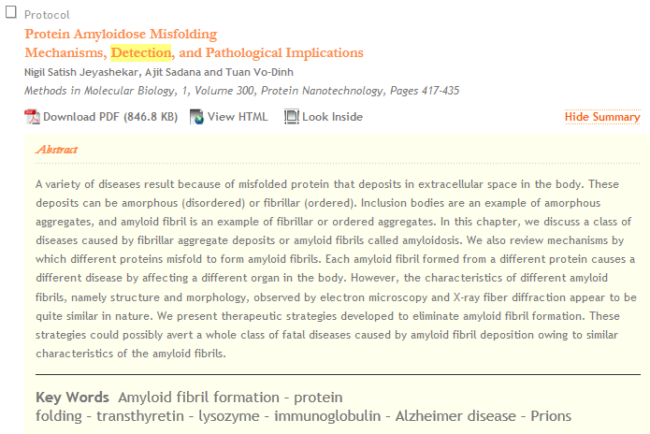
Protocols in SpringerLink

Slide 24
Business Model Options
Supplemental Info
Option 1: Access Only
Option 2: Ownership to subscribed years
  Access to all years while subscribed
Option 2a: Ownership to archive and subscribed years
  Reduced annual subscription

Slide 25
1. Access Only
Supplemental Info
Access: Access to the full collection (all subject collections/all years) or individual subject (all years) collections is available based on a calendar year basis. Subscriber must renew to maintain access.
Perpetual Access: No perpetual access. Once the subscription expires access will be terminated.
Example: If customer A has a subscription in 2009 and 2010 they maintain full access to the database. If they choose to discontinue their subscription in 2011 then access to the content is terminated.
Individual Subject Collections: Option to purchase by individual subject collections is available as an option

Slide 26
2. Annual subscription including archival rights
Supplemental Info
Access: Current subscribers are entitled full access to all Protocols contents included in the database until the subscription is cancelled.
Perpetual Access: Perpetual access is available only to years subscribed to.
Example: If customer A has a subscription in 2009 and 2010 they maintain full access to the database. If they choose to discontinue their subscription in 2011 then perpetual access is available to content from copyright 2009 to 2010.
Individual Subject Collections: Option to purchase under individual subject collections is not available.

Slide 27
2a. Full-Ownership Model
Supplemental Info
Access: Current subscribers are entitled full access to all Protocols content included in the database until the subscription is cancelled.
Perpetual Access: Perpetual access is available to all years subscribed.
Additional Provisions: Perpetual access must be purchased for archived content (1980 to year prior to current) to be entitled to special annual pricing. Payment for archive can be allocated over a period of three years. The first year subscription must include purchase of the archive and current year ownership.
Example: If customer A purchases the archive collection (1980-2008) and a subscription to 2009 they maintain full access to the database. If they choose to discontinue their subscription in 2010 perpetual access is available to content from copyright 1980 to 2009.
Individual Subject Collections: Option to purchase under individual subject collections is not available.

