Slide 1


Slide 2
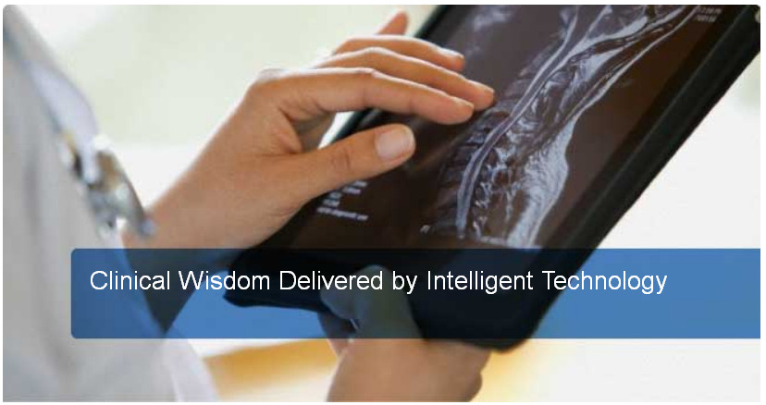
Meet Amirsys
Amirsys是谁?
全球顶尖的放射医学，病理学，解剖学的医疗信息提供商。
Amirsys, Inc.
Ric Harnsberger, MD Co-CEO
Paul Scholtes, JD,MS,MS Co-CEO
Julia Sherman, RPh EVP
Amirsys Publishing, Inc.
Anne Osborn, MD CEO
Paula Woodward, MD President
Notes:
This is the Executive Management slide, with an elevator pitch for our company.

Slide 3
您所知道的名字. 您所信赖的内容.®
逾300名放射医学，病理学和解剖学作者。
各自领域的学术专家
终身经验的精华
Notes:
All of our products rest on the superior content our authoring teams create.
Our team of renowned authors are specialists in their fields. Each of our 300 authors draws on a lifetime of experience and personal resources to create superior, specialized content for each diagnosis and anatomy topic.

Slide 4
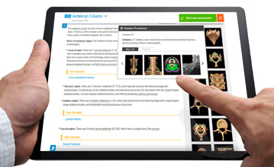
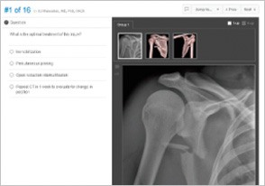

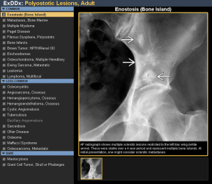
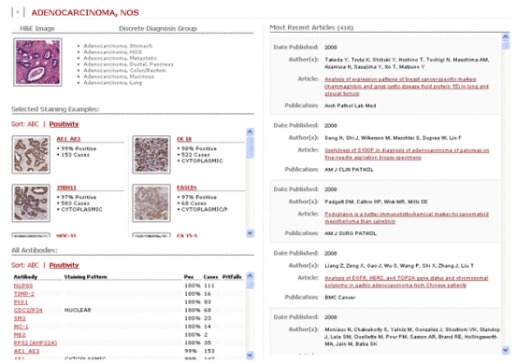
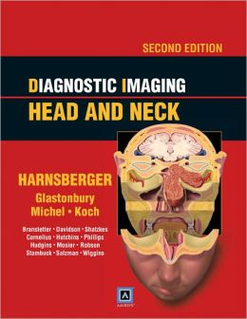

Amirsys 历史
成立
放射医学丛书
诊断图片
STATdx 发行
电子书发行
ImmunoQuery 发行
2001
2001
2003
2005
2006
2007
ACRES专利大奖
Amirsys Publishing 成立
RADPrimer 发行
AnatomyOne 发行
Osborn’s Brain 出版
Reference Centers 发行
2009
2009
2010
2012
2012
2013
Notes:
Speaking points from slide 5 of the previous presentation.
Founding Goals:
Create online, high-impact, concise, POC CDS for diagnosticians to improve the quality of patient care
Develop new technology to improve the teaching of resident trainees
Radiology origins
Produced books to pay for tech R&D – books became best-sellers
Added Pathology: key adjunct to radiology in hospital-based diagnostics
Added Anatomy: last of the Three Pillars of Diagnostic Medicine
Professionals Residents/Trainees Medical and other Students

Slide 5
Amirsys 今日
市场占有
> 99%的美国学术医学中心
全球
产品在逾50个国家每日使用
产品认知度
在线和印本产品被视作放射医学，病理学和解剖学领域的权威
成长
在线产品预计34%的销售增长率
Notes:
This is the “Quick Summary” from slide 3 of the previous presentation

Slide 6
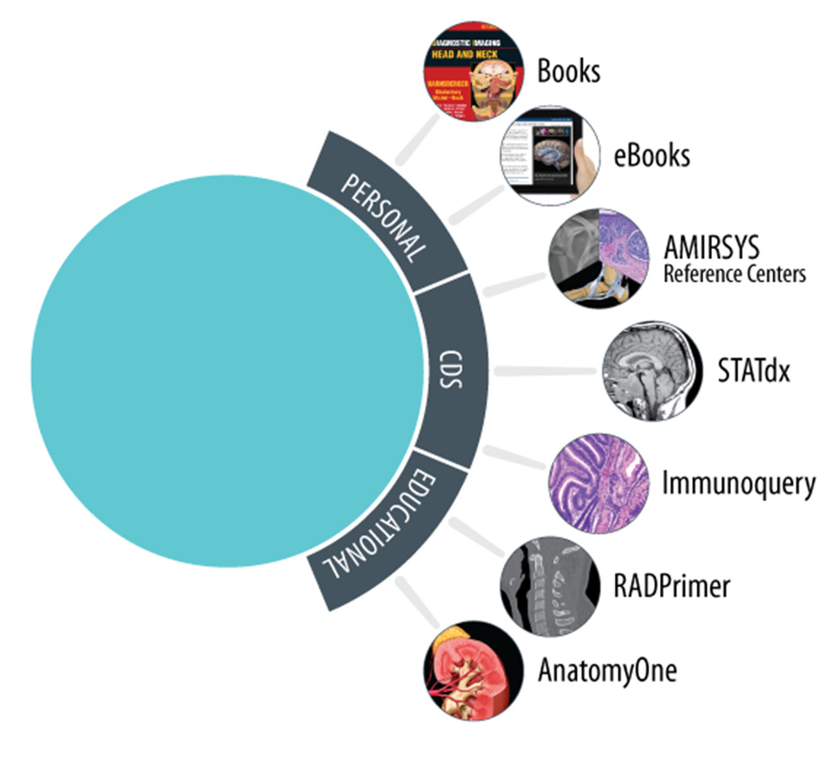
产品线
放射医学，病理学，解剖学领域的权威
Notes:
Cross Reference this slide 12 in the previous presentation
Amirsys is the Authority in Radiology, Pathology, and Anatomy
Personal Specialty Books and Ebooks
71 titles available in print and online
Online Clinical Decision Support – Point of Care
STATdx®: Radiology
ImmunoQuery®: Pathology
Amirsys Reference Centers™: Imaging, Pathology, Anatomy
Online Education/Learning Systems
AnatomyOne®: Anatomy
RADPrimer®: Radiology

Slide 7
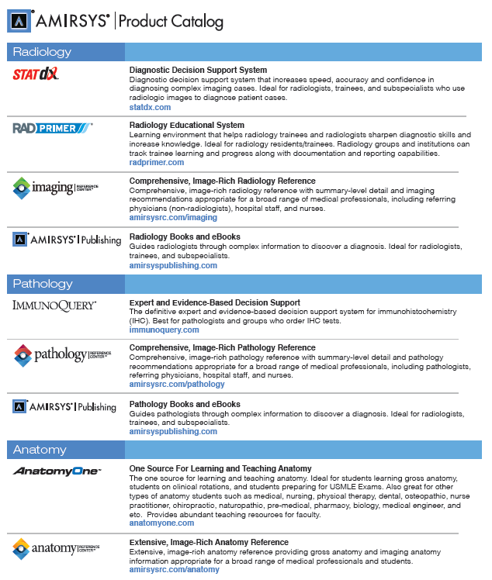
产品目录
Notes:
Again, emphasize radiology, pathology, and anatomy

Slide 8
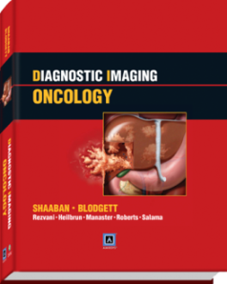
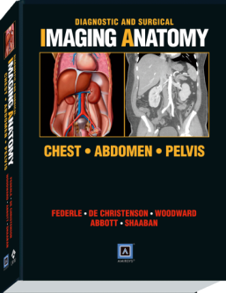
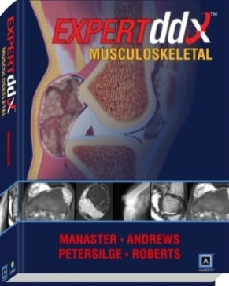
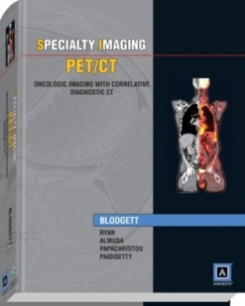
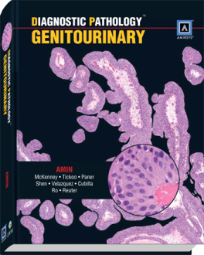
Amirsys Publishing’s
获奖的纸本书和电子书集合
病理学专辑
Diagnostic Pathology………………….24 Titles
放射医学专辑
Diagnostic Imaging……………………18 Titles
Specialty Imaging………………………15 Titles
EXPERTddx®…………………………………8 Titles
Diagnostic and Surgical……………….5 Titles
Imaging Anatomy
Osborn’s Brain……………..…………..….1 Title
71 本获奖书目
最畅销的
由世界知名的放射医学专家和病理学家撰写
省时, 子目录
综合性，高质量的放射医学和病理学图片
生动的医疗插图
Notes:
First in our product offerings are our personal products—our books and ebooks. Amirsys book titles are LWW’s best-selling radiology and pathology books.

Slide 9
Amirsys 电子产品
Get it right. 现在.
无论是医师做诊断，医疗专业人员帮助病患，住院医师学习测试，或是医科学生刚刚开始，我们所有的用户都需要获取正确的答案，就在现在。
Notes:
Our digital products are focused on helping medical professionals, residents, and students get it right, right now.

Slide 10

STATdx 概览
转为放射医学专家提供的在线的决策支持
在复杂的图片案列中增加速度，精确性和信心
综合覆盖每一个医学学科
Comprehensive coverage for every specialty
在全球逾50个国家使用
2005年起发行
Notes:
I’ve weeded a bit of what was here for STATdx so that we don’t overwhelm the Ovid folks with details about a product they won’t be selling.
STATdx was our first digital product:
Radiologists have more volume, less time
Increase speed and accuracy of diagnostic process
Online, comprehensive diagnostic system
Annual subscriptions
Individual radiologists, groups, hospital departments
Launched in 2005
33,000+ users (subscription)
Approx. 1,800 accounts (61% in U.S) (Approx. 7 accts buy each day)
50+ countries
500,000+ radiologic images and color illustrations
72,000+ topics
4,500+ diagnoses
9,600+ imaging anatomy images
23,000+ pages of original text

Slide 11
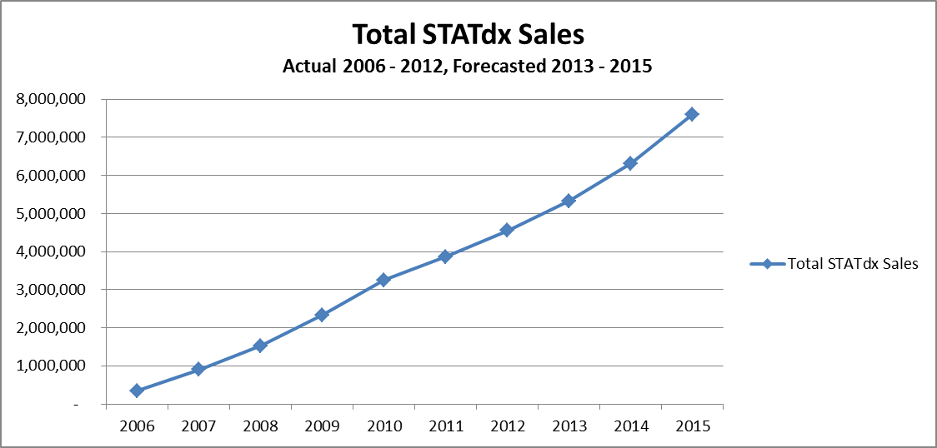
强而持续的增长
Notes:
Sales have steadily increased since 2006. This story is true of our other products, as well.

Slide 12
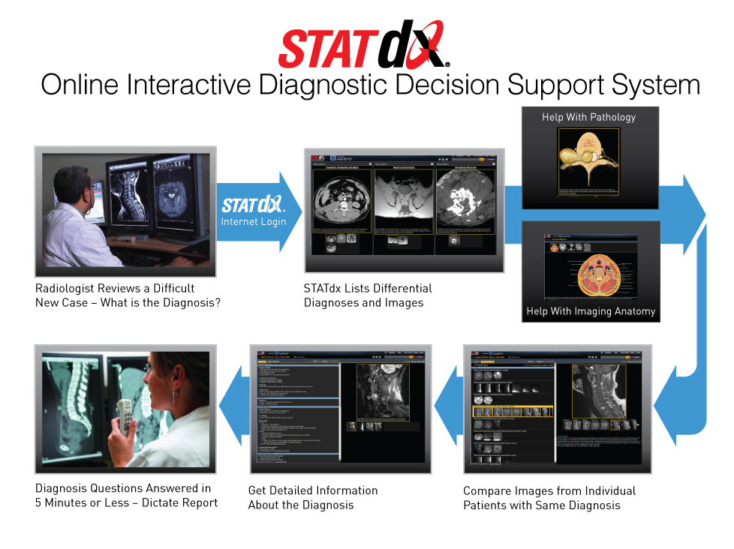
Notes:
Let’s talk about how a radiologist might use STATdx.

Slide 13
ImmunoQuery 概览
转为免疫组织化学专家提供的偱证决策支持工具
在诊断病理学案例中增加速度，精确性和信心
在线并且综合
全球使用
2007年起发行
Notes:
ImmunoQuery is another of our well-known online decision support products.

Slide 14

ImmunoQuery
Notes:
6,500+ users (subscription)
1,266,000 immunostain patient cases
54,000 unique antibody results
4,900 peer-reviewed references
3,000 diagnoses
2,500 unique antibody clones

Slide 15
Amirsys Reference Centers 概览
放射医学，病理学和解剖学参考工具。
为广阔的医疗专业人员提供
经典的诊断和图片样本
在医学检索过程中，提供放射医学，病理学和解剖学的观点
Notes:
The Amirsys Reference Centers are our newest product line. We are already seeing tremendous success in sales for these products.

Slide 16
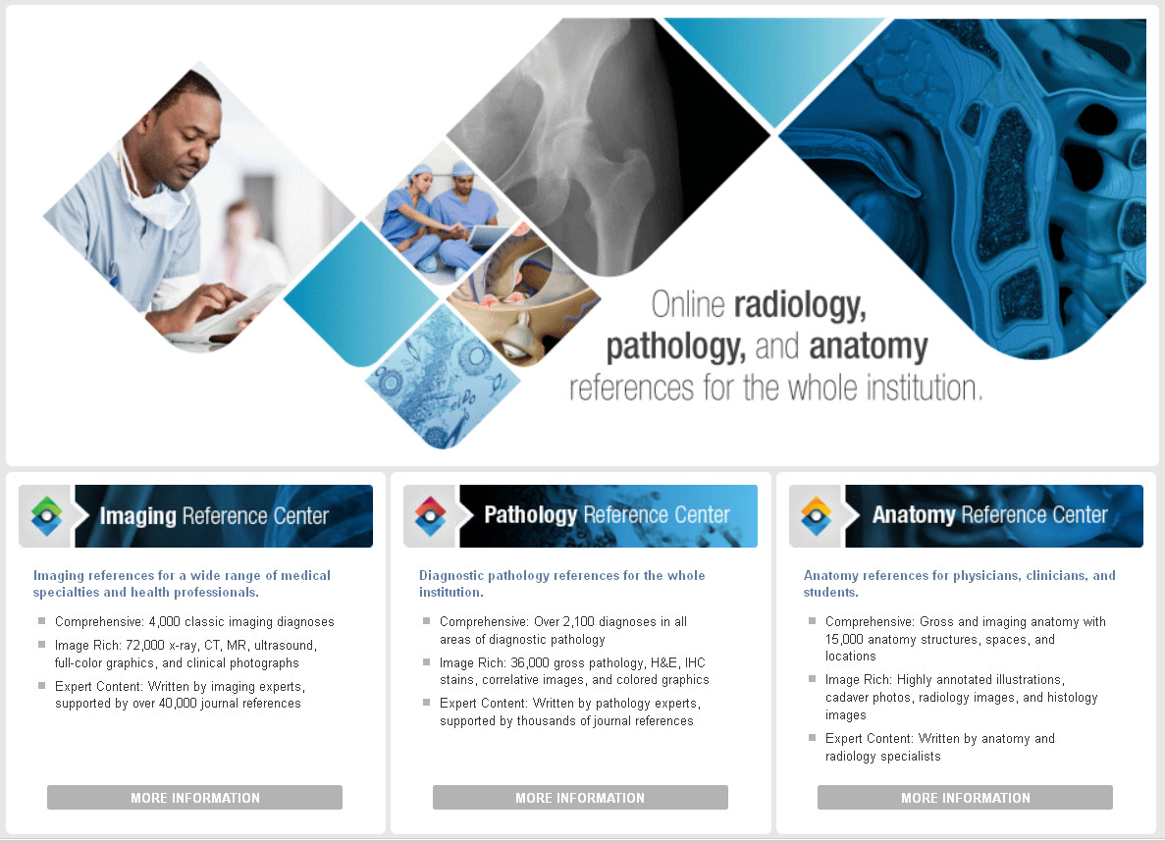

Slide 17

演示

Slide 18
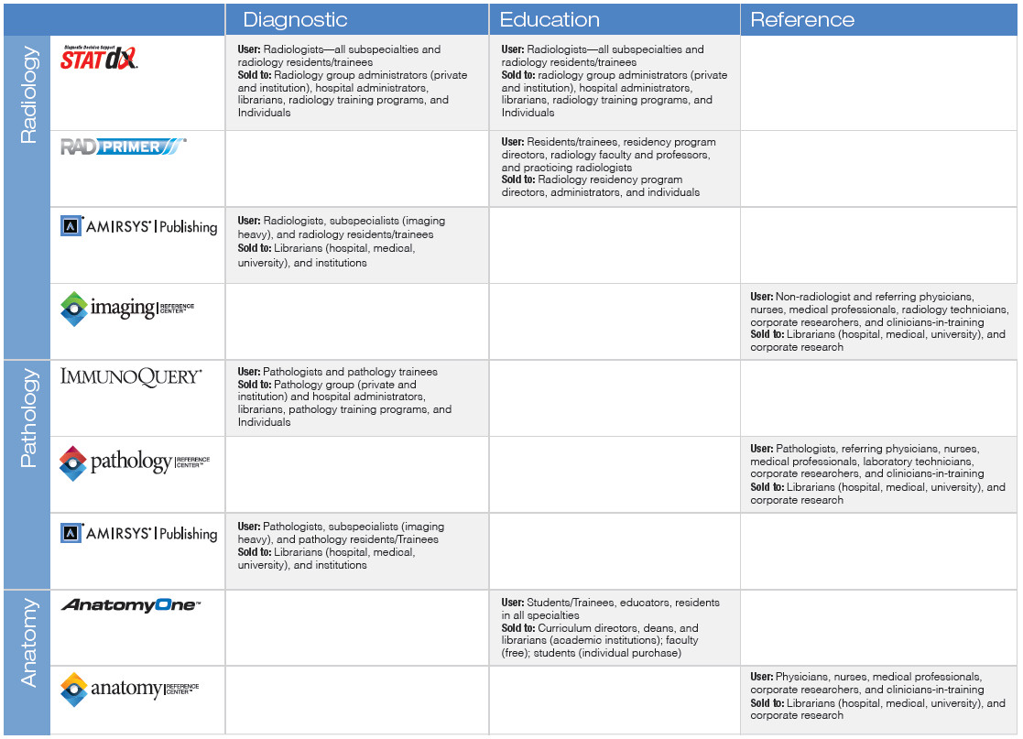
Amirsys 用户和针对性
Notes:
We’ve included a quick guide to help you understand the differences between the users of each product.
Let’s take a a closer look so that you can understand the differences between the Reference Centers and our other products.

Slide 19

放射学 产品 分类
IRC
一个专为广泛的医疗专业人员研发的易于检索的在线参考工具，可帮助医疗人员在诊断和评估放射检测时获得放射医学的观点。收录4000个经典的放射医学诊断和72000张高清图片。
STATdx
一个专为放射医学专业人员提供的的决策支持系统，以帮助他们做出正确的决策。包括诊断，差别诊断，图片解剖学，RAD工具（比如癌症分期工具），处理，和逐一诊断比较。
Radiology eBooks
Amirsys放射医学电子书，尤其是由对于广泛阅读放射医学有兴趣的放射医学专家所使用。

Slide 20

放射学 产品 分类
PRC
一个专为广泛的医疗专业人员研发的易于检索的在线参考工具，以期帮助医疗人员在诊断或评估病理学检测时获得病理学观点。收录2100个经典的病理学诊断和36000张高清图谱。
eBooks
Amirsys病理学电子书，专为对于广泛阅读病理学学科内容感兴趣的病理学家所使用。

