Slide 1
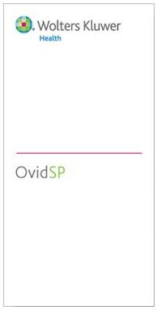
Ovid – Your Complete Online Research Solution
科研在线整体解决方案
李宁
销售工程师
培训经理
中国医科院
2014年6月

Slide 2


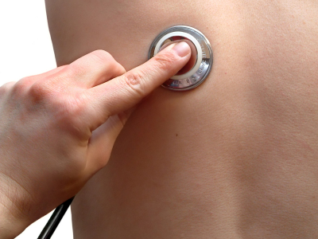
Wolters Kluwer Health 威科集团医学部
Focused on clinicians from learning to practice to improve access, quality and cost effectiveness of healthcare
Professional & Education
Medical Research
Clinical Solutions
Learning
Research
Care
提供医学、护理学教育材料和在线学习工具
提供高质量的医学信息和精准的检索平台
为医学从业者提供治疗方案参考
Lippincott Williams & Wilkins
UpToDate, Medi-Span,
ProVation Medical
Ovid
Physicians | Nurses | Pharmacists | Allied health
Notes:
Wolters Kluwer Health is the third largest division of Wolters Kluwer supporting Legal & Regulatory, Tax & Accounting and Financial Service information services sectors. Within our Health Division, we provide content and solutions to support Education/Learning, Medical Research and Point of Care.
Medical Research includes familiar product brand names Lippincott Williams & Wilkins journals, Ovid – global online research platform offering 3rd party and proprietary content, and in 2011, we acquired Medknow, an open access publishing services business based in India.

Slide 3



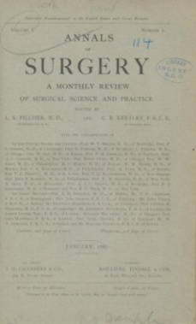
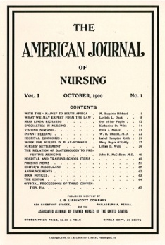



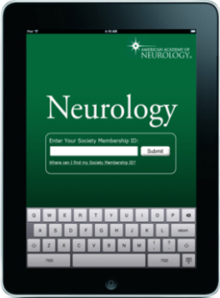
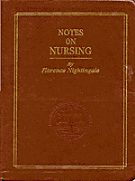



超过200年历史
1792 Philadelphia bookstall opens which will develop into book publisher J.B. Lippincott
1885 Lippincott publishes first journal, Annals
of Surgery
1900 Lippincott launches The American Journal of Nursing
1990 Wolters Kluwer acquires J.B. Lippincott which has grown to publish nearly 300 periodicals and 1500 books in over 100 medical disciplines.
1836 Wolters founded in the Netherlands
1889 Kluwer starts business
1998 Wolters Kluwer acquires Ovid
2011 OvidMD launched; and Ovid local language with OvidChinese, OvidEspanol
2011 LWW introduces journal iPad apps
2011 Wolters Kluwer Health acquires Medknow Open access platform
1878 Lippincott publishes first text book for nurses
1988 Ovid founded
Notes:
You may need to define “HCP” for your audience.
A good talking point might be that our first medical journal was Annals of Surgery and our first nursing journal, American Journal of Nursing. LWW still publishes these titles today.

Slide 4

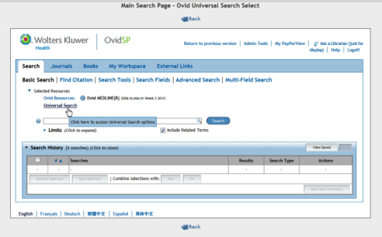


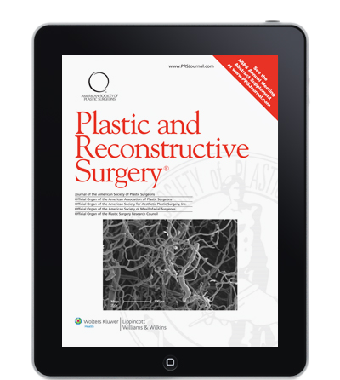

高质量内容和精准检索
used by healthcare professionals
高水准的内容
传播渠道
客户/用户
Physicians
Lippincott, Williams & Wilkins
Exclusive access
Ovid
Hospital
Nurses
  Leading WK Expertise
3rd Party
Content & tools
Medical / Academic
School
Students, Educators
  Scholarly research and peer review
Librarians
Medknow
Government
Researchers
Corporate
Information
Managers
Notes:
So what does Wolters Kluwer Medical Research do?
Most important, we provide critical content.
Our Lippincott, Williams and Wilkins brand includes propriety journals and exclusive partnerships with over 80 leading medical and nursing societies, such as the American Heart Association, the American Society of Anesthesiologists, and the American Association of Physician Assistants. These journals provide the latest discoveries in their field as soon as they are available.
We also license selected third party content and tools, including from some of our competitors, in order to provide a one-stop-shop for our customers.
More recently, we have added open access content. We acquired Medknow, a business based in India, in late 2011. Medknow provides publishing services and global distribution via open access to over 300 medical societies from India, China, Korea, Egypt, Turkey and many other countries. These societies publish in English and are eager to make their journal articles available to researchers around the globe.
For those not familiar with the concept of open access or who struggle with its many definitions, open access is a business model by which the research funder or author pays for the right to distribute the content free of charge. In some cases, that right includes commercial re-use, but in most it does not.
And government-mandates for open access allow for an embargo period before content can be made freely available. For example, the U.S. National Institution of Health public access policy allows for 12 month embargo period before content is available on PubMed Central. The RCUK mandate indicates a strong preference for immediate open access, but does support an option with an embargo period of at least 6 months if an open access option is not offered by a journal.
Finally, to be successful, open access content, just like any medical research content, must be adequately peer reviewed so that it can be trusted as good science.
Delivery of our content takes a variety of forms, but our key revenue stream is the global Ovid online platform used by over 12,500 institutions in 186 countries. Almost all of our content is delivered on a subscription basis.
The institutions we sell to include hospitals, medical schools, government, and corporations such as pharmaceutical companies and device manufacturers. We generally sell to the librarian, but we also work with others in the organization, such as the head of the residency program, to ensure we deliver the right products to meet their needs and that the products are adopted successfully.
And our end users range from doctors and nurses to students to in-depth researchers.

Slide 5
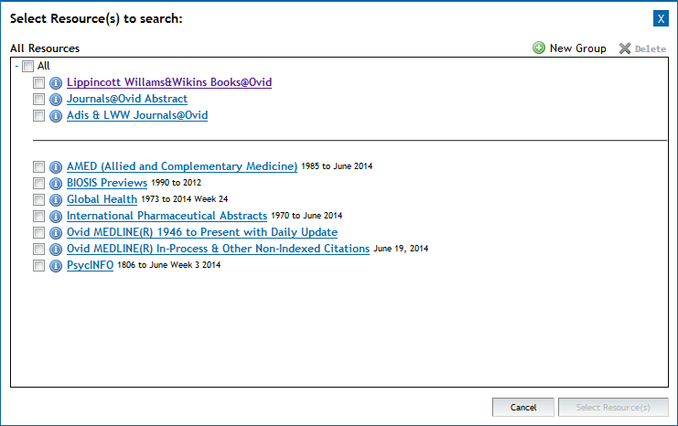
医科院订购的Ovid资源
全文资源库
文摘资源库

Slide 6
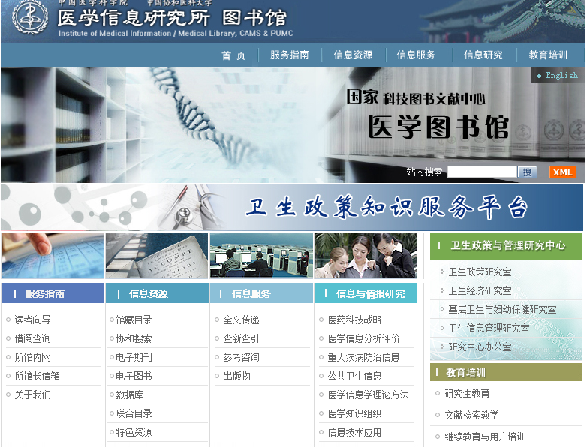

Slide 7
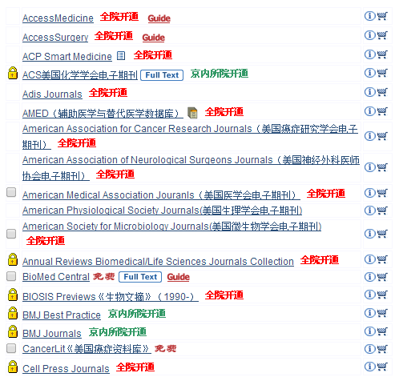
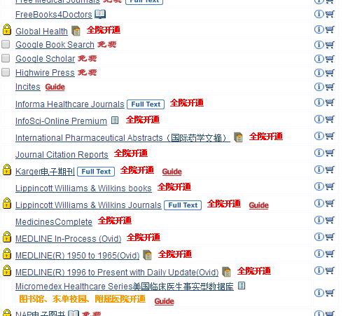

Slide 8
LWW 医学资源

Slide 9
关于Lippincott Williams & Wilkins
  Lippincott Williams & Wilkins (LWW)是一家国际领先的专业医学出版社；
  提供高质量、专业的医疗保健信息，涵盖电子和印本资源；
  服务于内外科医师、护士、医科学生等医学用户；资源类型包括教科书、期刊、药物指南、电子图书、iPad客户端等。
  最早起源于1792年费城的一家书报摊；在60年内成长为一家著名的出版商；经过1978、1990年的合并，最终于1998年成为ＬＷＷ。

Slide 10
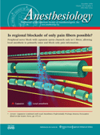
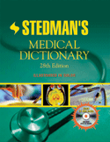


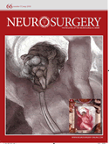
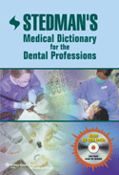
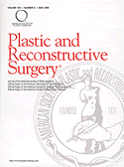



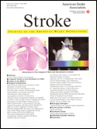
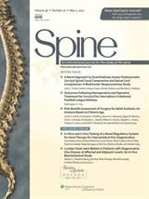
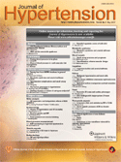
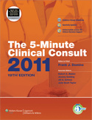



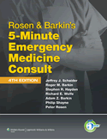
LWW Collection

Slide 11

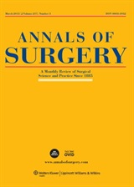

LWW期刊亮点
  6种期刊在7个JCR目录中排名第一
        Circulation, 由American Heart Association（美国心脏学会）出版, 在Cardiac and Cardiovascular Systems（心脏和心血管系统） and Peripheral Vascular Disease （外周血管）排名第一. (IF 15.202*)
        Annals of Surgery, 由American Surgical Association（美国外科学会） 和 European Surgical Association（欧洲外科学会）联合出版, 在Surgery （外科学）排名第一.
        (IF 6.329*)
        The Journal of Head Trauma Rehabilitation, 是Brain Injury Association of America （美国脑损伤协会）的官方期刊，经过同行评议，在康复医学中排名第一.
        (IF 4.443*)
*2012 Journal Citation Reports® (Thomson Reuters, 2013)

Slide 12



LWW期刊亮点
  6种期刊在7个JCR目录中排名第一
        Ear and Hearing, American Auditory Society（美国听觉协会）的官方期刊, 在Otorhinolaryngology（耳鼻喉科学）排名第一.
        (IF 3.262*)
        Epidemiology, International Society for Environmental Epidemiology（国际环境流行病学会）官方期刊, 在Public, Environmental & Occupational Health（公共、环境、职业保健）排名第一.
        (IF 5.738*)
        Circulation Research, American Heart Association（美国心脏学会）期刊, 在Hematology（血液学）排名第一.
        (IF 11.86*1)
*2012 Journal Citation Reports® (Thomson Reuters, 2013)

Slide 13



Slide 14
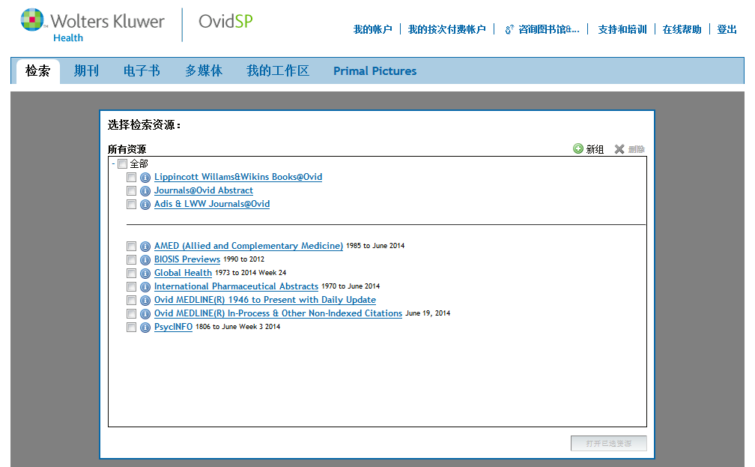
选择一个或多个数据库

Slide 15
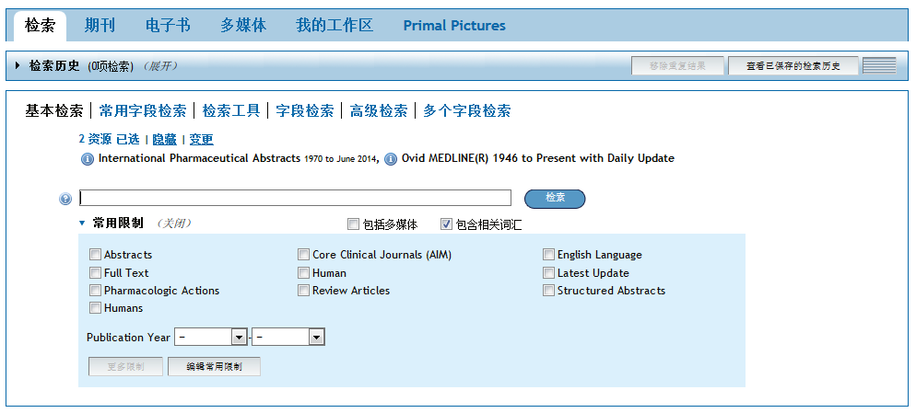
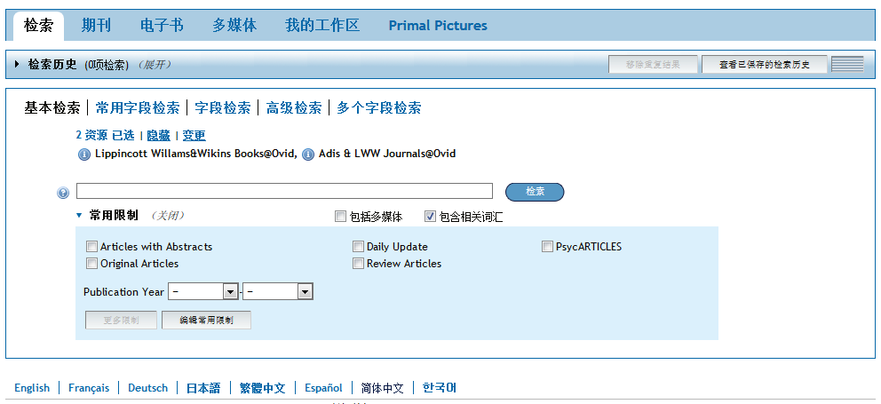
Ovid 的检索页面，将多种检索模式、限制条件、检索历史，以及结果管理工具整合在一个界面
点击“变更”，更改所选数据库

Slide 16
OvidSP 平台提供多种检索模式
基本检索用于查找某个科研课题或问题
利用高级检索进行互动式的主题检索
多字段检索组合字段检索和主题检索，生成复杂的检索策略
常用字段检索通过常用引文字段定位某个或几篇文献
检索工具用于浏览主题词的书型结构
浏览或检索单个、多个或所有字段，则运用字段检索

Slide 17
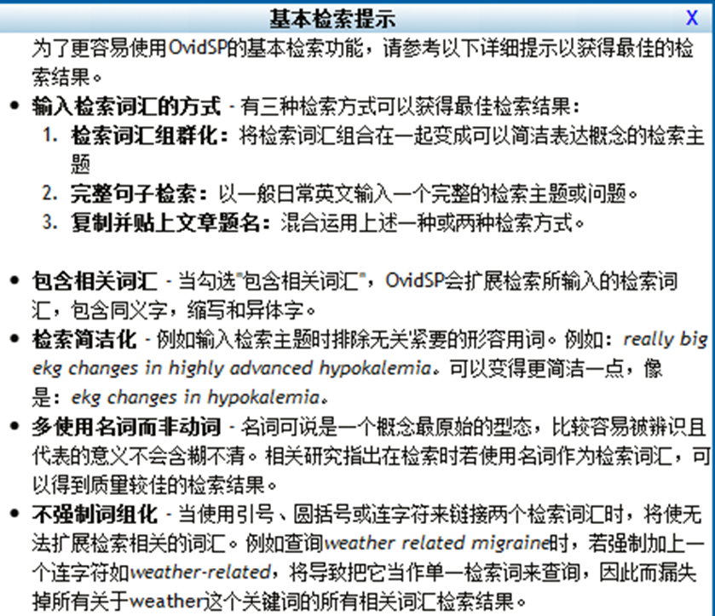
基本检索
基本检索是自然语言检索，输入一个完整的检索问题或话题，找到最近几年发表的相关文献。
Aspirin and heart disease

Slide 18
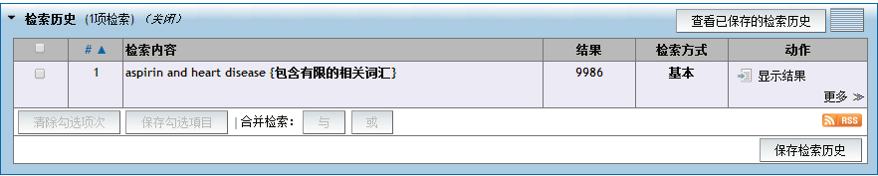
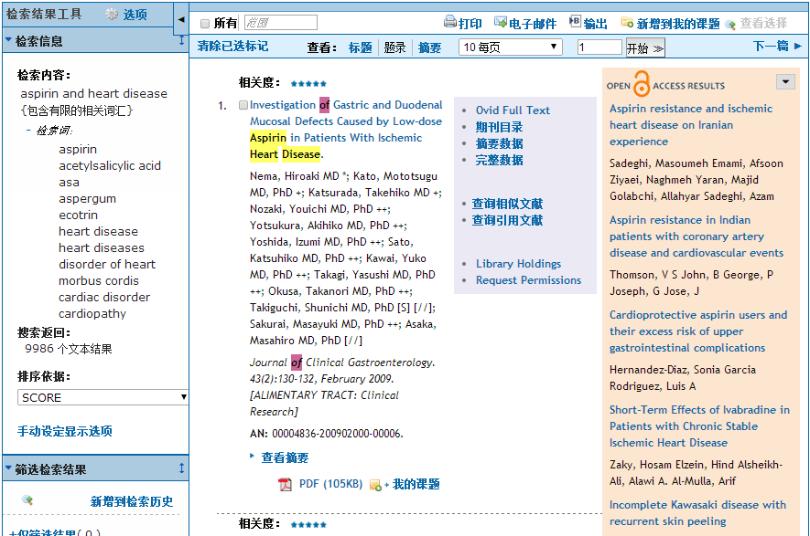

Slide 19
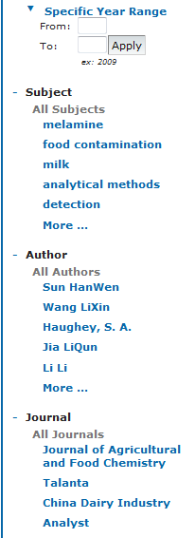
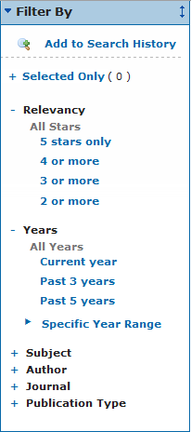

Slide 20
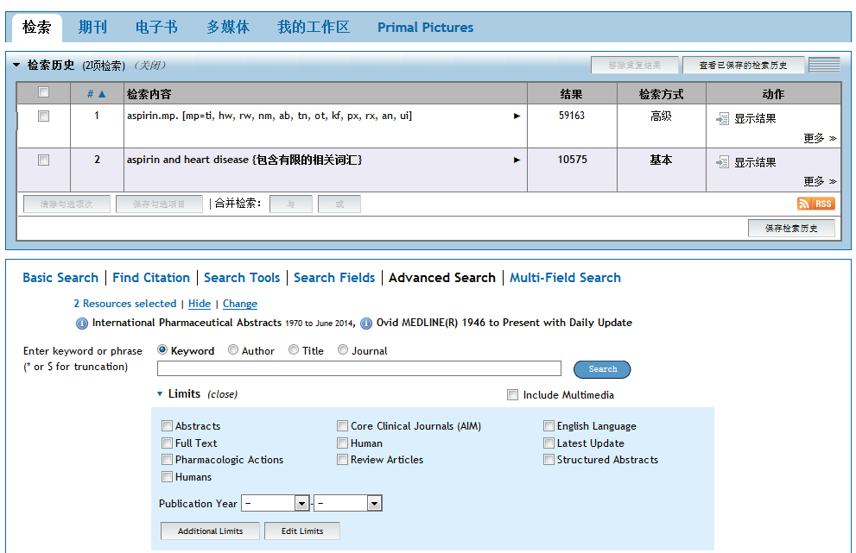
高级检索： 关键词检索

Slide 21
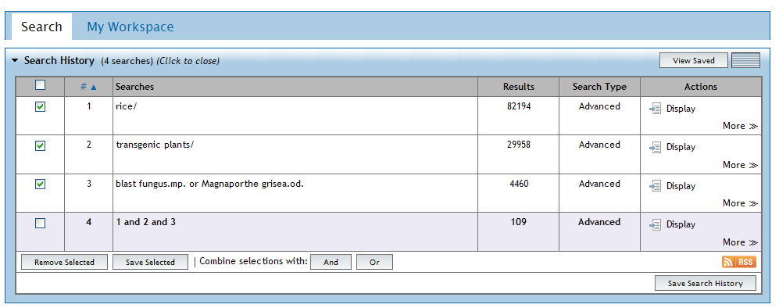
组合检索
AND – 包含两个或多个主题
OR – 包含其中一个主题
NOT – 去掉一个主题 (1 not 2, rice not oryza)
ADJ# - 检索词之间相距一定数目的单词 – (rice adj6 straw)
Notes:
Say: This brings our completed searches together to form an answer to a topic query – “articles about Blast fungus infestations in rice in China” for example. Number 6 is either blast fungus or the organism, 7 is a combination of all the subjects together. Blue font combinations are avaialable from the Search History menu, the others need to be entered on the command line.

Slide 22



关键词检索，运用截词符
$ or * --替代0-n个字符
# --替代1个字符
？ --替代0或1个字符

Slide 23
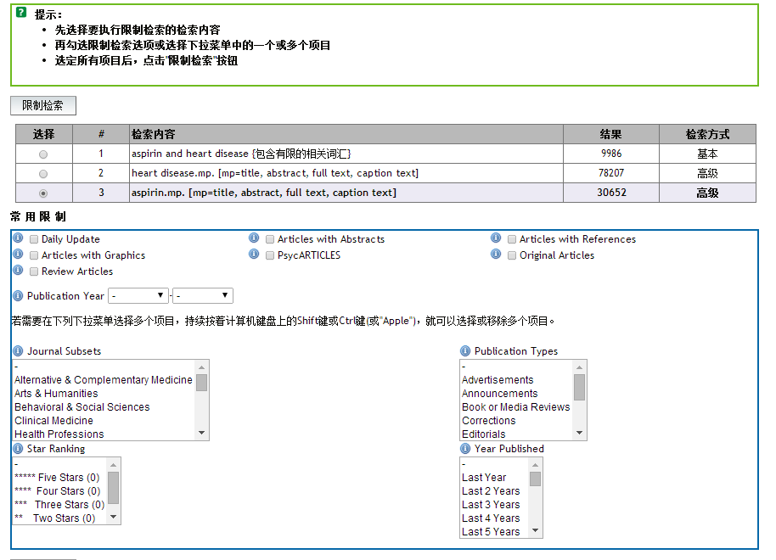
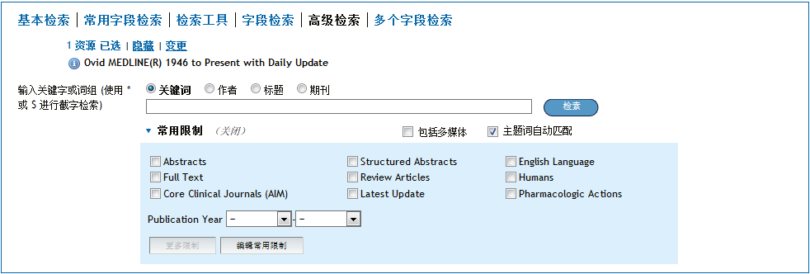
限制条件 Limits

Slide 24
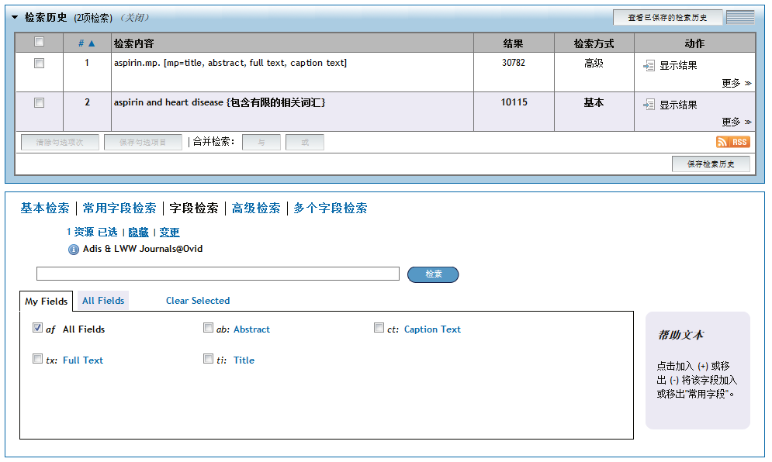
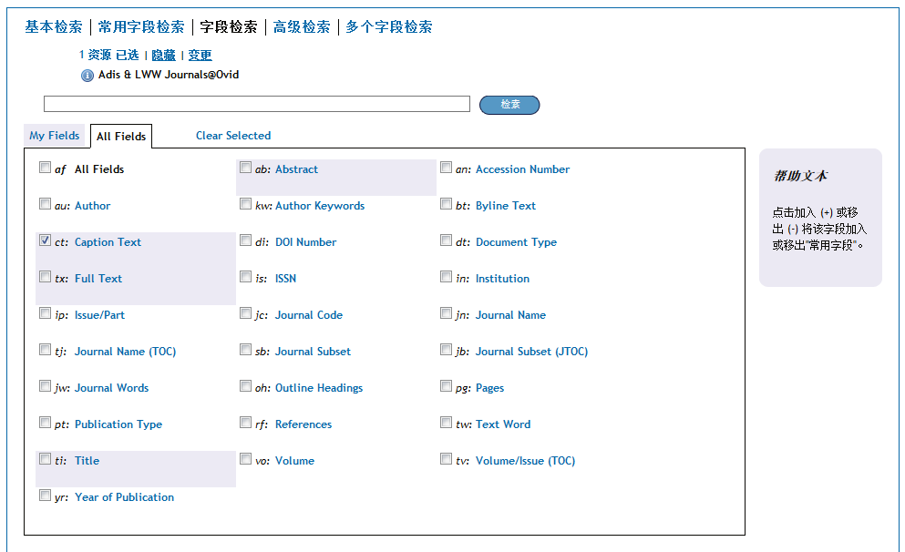
字段检索

Slide 25
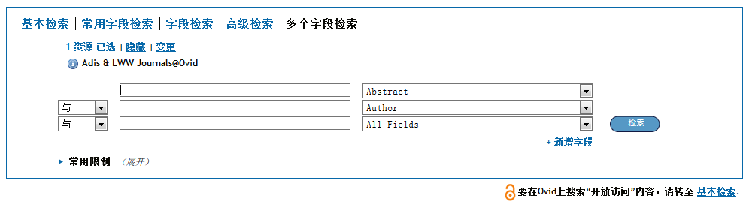
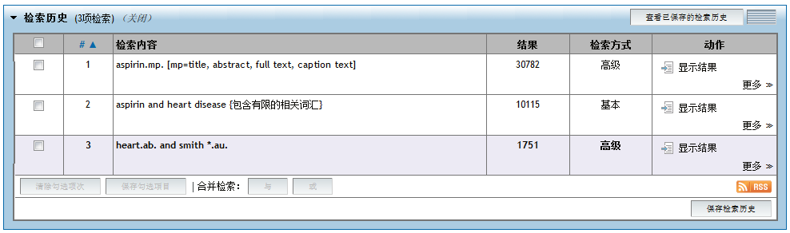
多字段检索

Slide 26
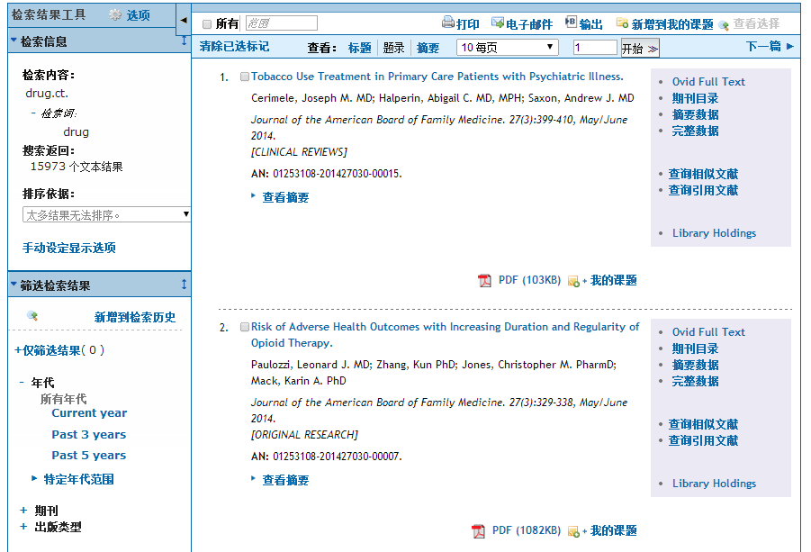
打印、电子邮件、输出

Slide 27
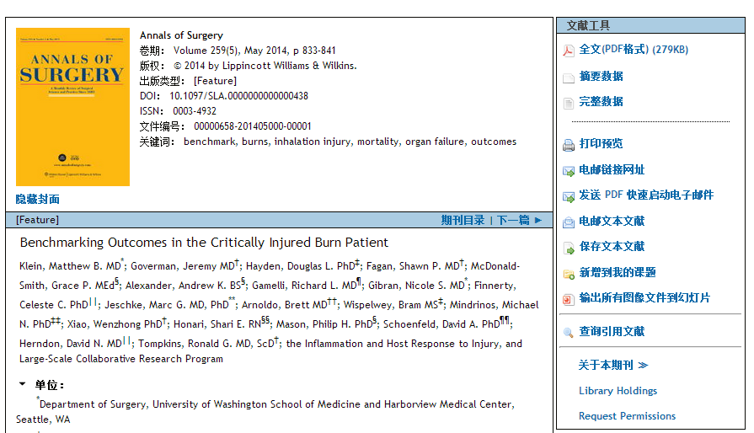
文献工具

Slide 28
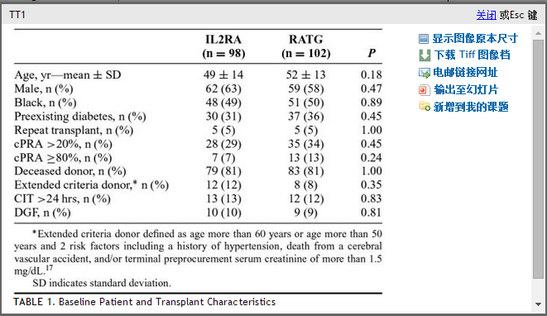
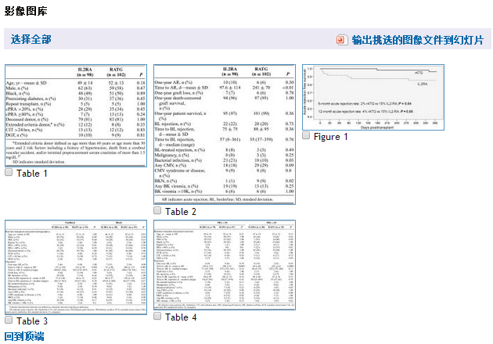
文献工具

Slide 29
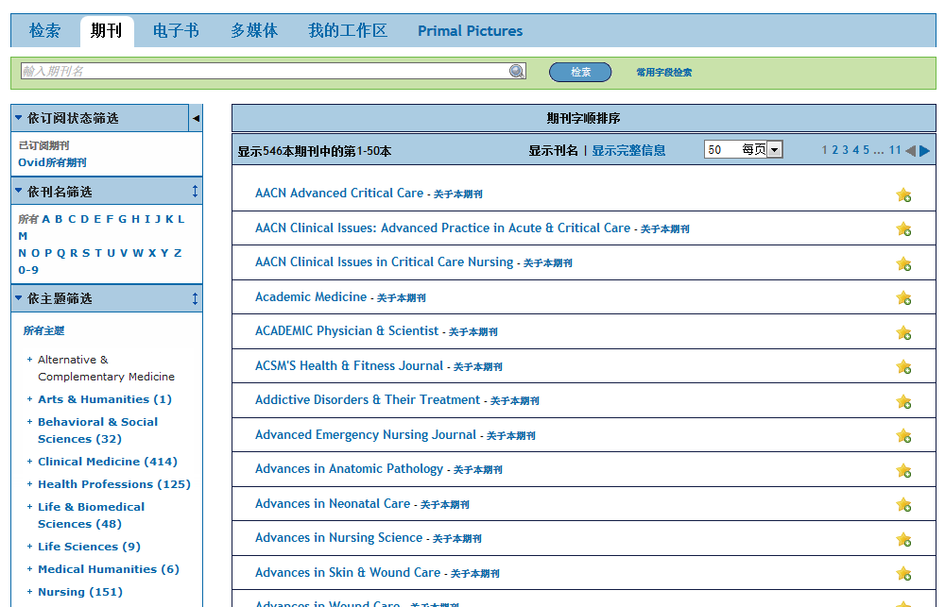
期刊浏览
按刊名进行浏览
按学科进行浏览

Slide 30
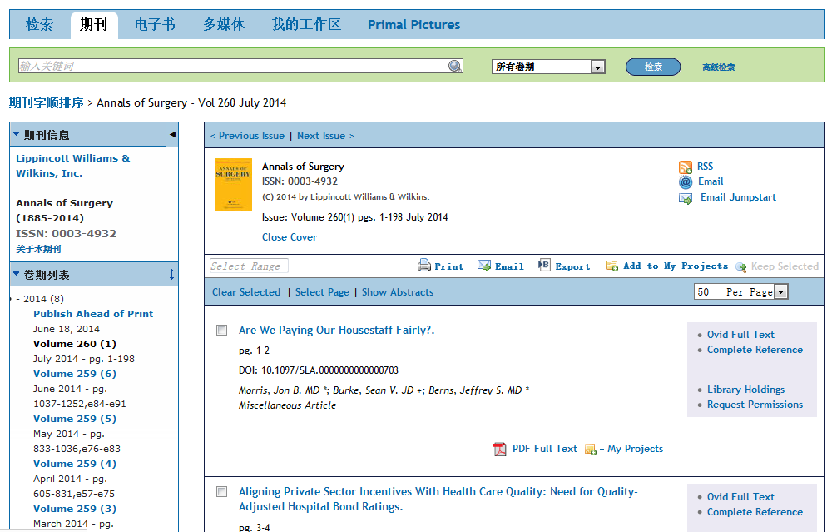
单刊浏览

Slide 31
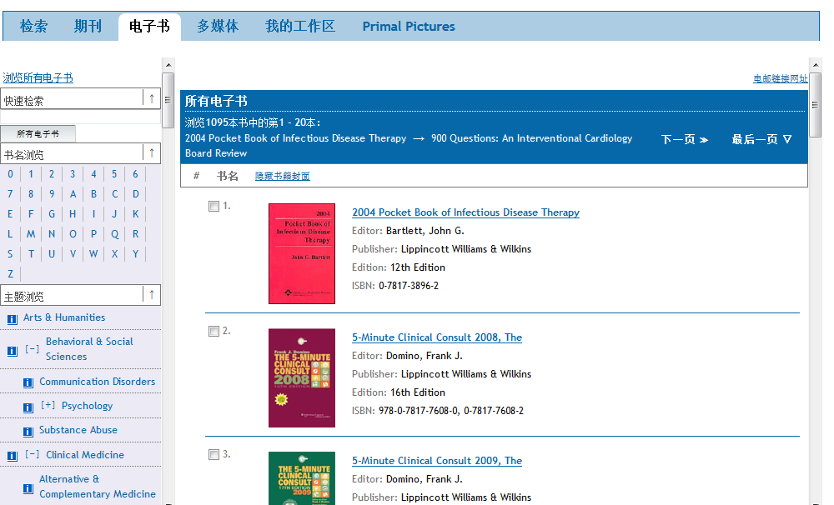
图书浏览
快速检索
按书名进行浏览
按学科进行浏览

Slide 32
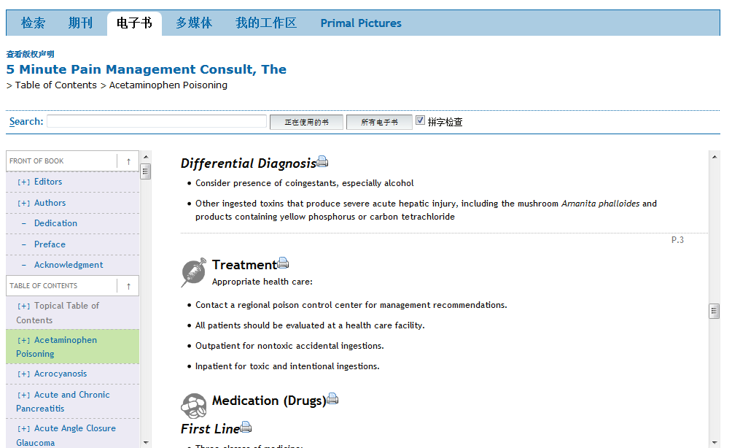
单本书浏览

Slide 33
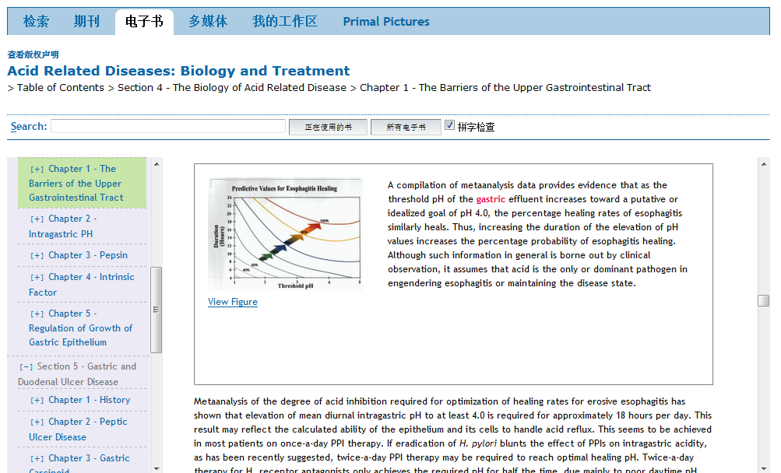
单本书浏览

Slide 34
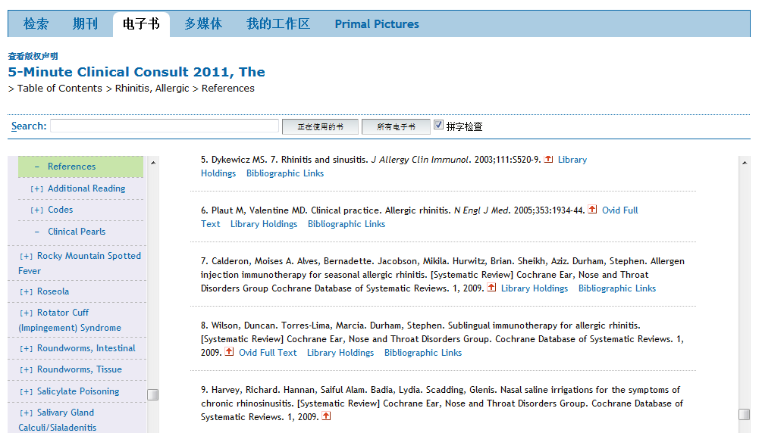
单本书浏览

Slide 35
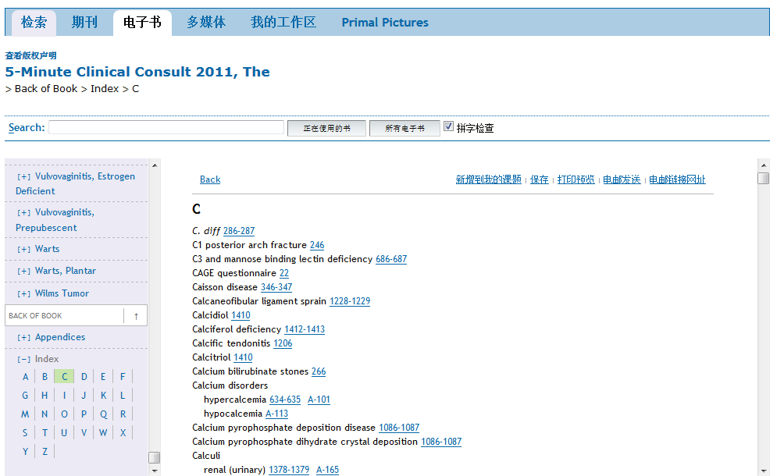
单本书-索引

Slide 36

Ovid平台上的多媒体资源

Slide 37

轻松获取多媒体资源
轻松访问
灵活使用
准确关联

Slide 38
灵活使用
高级检索、字段检索仍然可以使用
支持自然语言检索、多媒体标题检索；基本检索可以快速获取结果
Notes:
-

Slide 39

轻松访问
快速便捷访问多媒体资源
在文字检索和多媒体结果之间自由转换

Slide 40

多种筛选方式
通过筛选功能快速有效获取相关结果
你想看最新的多媒体资源？或你想指定某一种资源类型？
多媒体时长——你只有午饭时间可以看视频？或你只有5分钟快速浏览？
你想看视频还是图片？或是都想了解一下？
你想了解某一科系的信息？
Notes:
-

Slide 41

浏览“Browse”多媒体资源
如果你想浏览多媒体资源
同时可以快速访问全文信息
查看某一具体学科的信息

Slide 42

视频播放
将多媒体资源下载到你的计算机，或添加到个人账户。
觉得有用？再看看该篇文章中的其他多媒体资源

Slide 43



应用实例
检索Skin Grafts（植皮手术），观看头部的植皮手术
在神经外科（Neurosurgery）中检索Waterjet Dissection（水射流切割），获取3个系列视频，学习脑内操作的每一步
观察一个发育10周的quadruplet（四胞胎）超声波图
查看由于导管敷料引起的contact dermatitis（接触性皮炎）图片

Slide 44


Slide 45


创建个人账户

Slide 46

我的工作区

Slide 47
加进我的课题
以下项目可被加入到我的课题或文件夹:
  Ovid Results （Ovid检索結果）
  Ovid Universal Search results （ Ovid Universal检索結果）
  Saved Searches （储存的检索历史）
  Journal Articles – PDF or HTML （期刊文章全文– PDF or HTML ）
  Images （图像）
  Text Snippets （文本剪贴）
  User-created Citations （客戶自己生成的题录）
  Book Chapter （电子书章节）
  Journal Issue List result （期刊目录結果）
  Auto-Alert results （储存定题通告）
  Uploaded files （上传文件）
Notes:
47
Items which may be added to a project or folder

Slide 48


Slide 49


我的检索与定题通告

Slide 50

期刊订阅

Slide 51


Slide 52



安装工具栏

Slide 53



Ovid加速、简化研究工作
Increased value as growth of medical content continues
案例 – 医师（Physician）:
如果一名患者患有心力衰竭，如何对该患者的类风湿关节炎进行有效药物治疗？
Ovid优势: 检索多个临床医学库，如 EBMR, Embase, Ovid Medline查看相关病例报告，或分析综述
  案例 – 医学学生（Medical Student）:
  住院医师观看播客和视频为新的临床实习做准备
  Ovid优势: 嵌入临床流程的多媒体内容
  案例 – 医学图书馆员（Medical Librarian）:
  肿瘤学团队，图书馆员创建高级检索策略，从而作为干细胞移植综述的一部分内容
  Ovid优势: 涵盖范围广的询证医学内容和检索工具，帮助准确搜索文献；RSS和Alert帮助团队及时获取最新进展
Notes:
So now that you have a good picture of what Wolters Kluwer Medical Research does, let me give you a few examples of how our products are used to accelerate medical knowledge.
As I mentioned, doctors and nurses don’t generally use our products when they are with patients, but on a break they might use Ovid to look up the appropriate drug therapy for a patient with two conditions. Because Ovid is a one-stop shop, they are able to search all of the key evidence-based medicine databases available in the market to quickly find their answer and have confidence they’ve found the right information.
I mentioned earlier that students start using medical research while they are still in school. For example, a resident might search for a video to review a procedure before going into a new clinical rotation.
Finally, I’ve mentioned that medical researchers use Ovid extensively. For example, more complex medical questions can require what’s called a systematic review, which is a very in-depth analysis of medical literature. A researcher might use Ovid to both identify all of the relevant existing research on a topic, such as stem cell transplants, and to be alerted to new developments.
These are just a few examples of how Wolters Kluwer Medical Research helps medical professionals deliver results every day. In fact, it’s searched 132 million times per year.

Slide 54















OvidSP 提供全面解决方案，满足您的需求 !
Notes:
Adapting YOUR Ovid to your users…
Comments:
OvidSP is much more and has much more to offer than what we see,
Tell us what you want so we can evaluate its possibilities of integration in future OvidSP releases
Ovid listen to his customers: as a matter of fact the whole OvidSP has been developed following our Customers comments, requirements, needs and feedback.
Ovid moves along with the latest technology, always in the vanguard: RSS, twitter, YouTube, etc…

Slide 55



如需要更多详细内容
        support@ovid.com or 访问 http://resourcenter.ovid.com

Slide 56
问题?
非常感谢!
李宁
Ovid培训经理
Ning.li@wolterskluwer.com
support@ovid.com

